Slide 1
Welcome to the
Engagement
Management (Add-on)
Team!

Slide 2
Agenda
  Introductions
  General Position Overview
    Job Responsibilities
    Expectations with Manager
  PTO guidelines
    PTO Request Form and Calendar
  Confirm job schedule & hours
  Recurring 1:1
  Annual and Mid-Year Review Process
  Onboarding Calendar and Training Plan
  Team Review
    Navigation
    Teams Channels and Files

Slide 3
Introductions

Slide 4
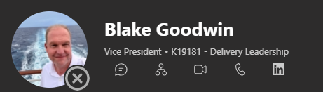
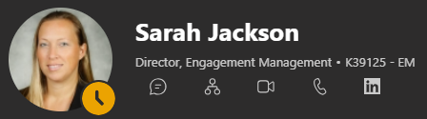
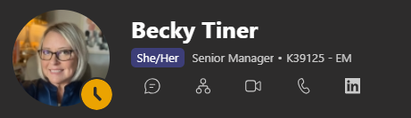
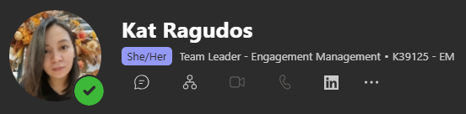
Your Leaders

Slide 5
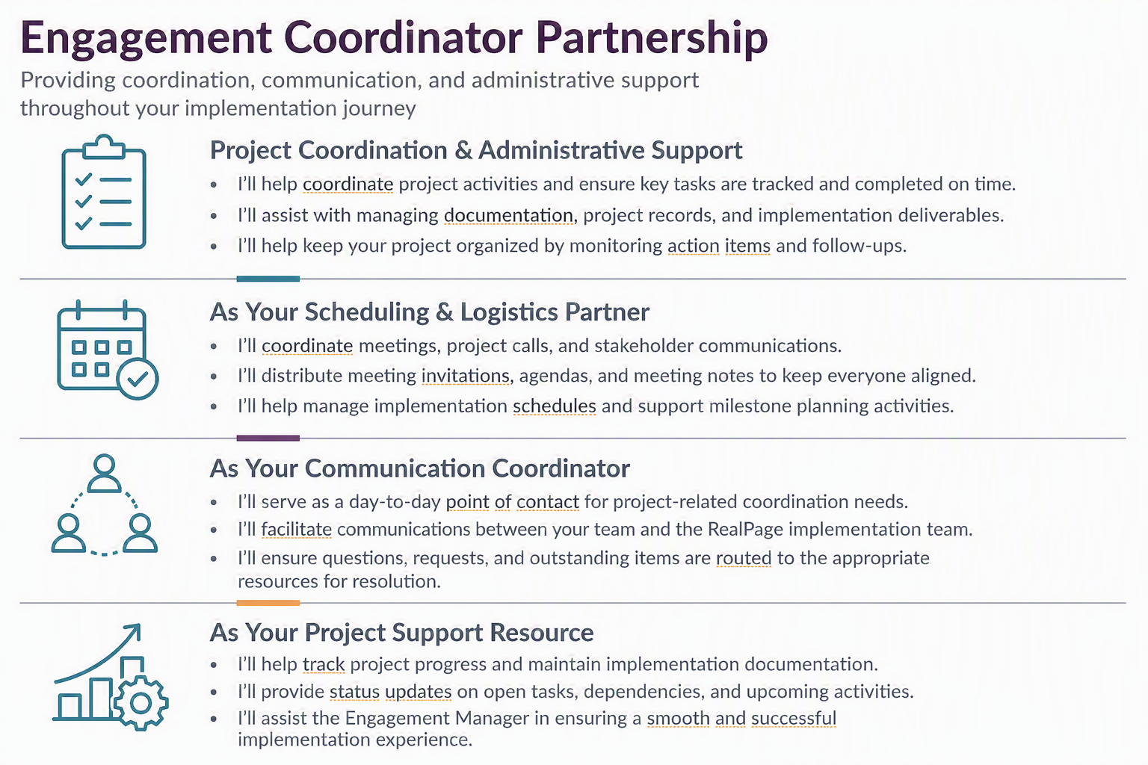
Position Overview

Slide 6
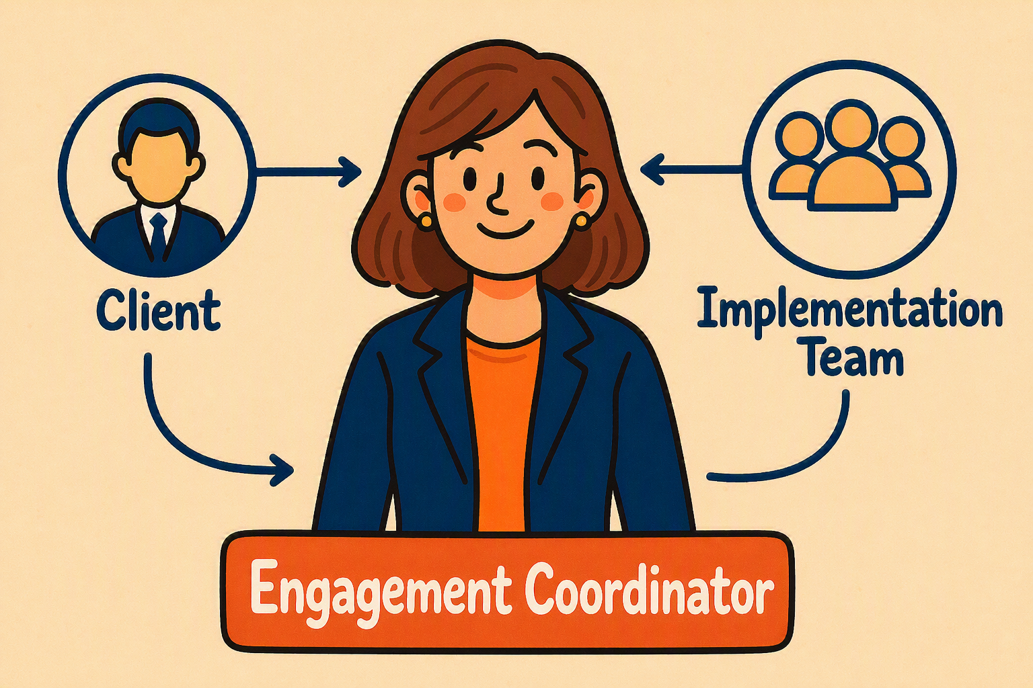
Position Overview

Slide 7
Expectations with Manager
  UPDATE & BE ORGANIZED
    Project Trackers
    Smartsheet trackers
    EC Action Item Tracker
    EC Lessons Learned
  DOCUMENT
    Conversations
    Agenda
    Recap
    Meetings

Slide 8
Expectations with Manager
  RISK MITIGATION
    Possible Escalations/Issues
    Client Sentiment/Temperature
    Implementation Errors
    Upcoming projects
  COMMUNICATE (ASK & RESPOND)
    If it takes more than 5 mins ask
    Utilize Teams chats
    Don’t hesitate to reach out to other teams
    Respond to clients emails asap (acknowledgement)

Slide 9
Expectations with Manager
  PROBLEM SOLVING MINDSET
    You’re not the SME but you can help gather the experts to resolve the issue
  STAY WITHIN YOUR SWIMLANE
    Help Organize but call out if you feel like it is already outside your scope
    Point them to the right direction
    Teach them how to fish

Slide 10
Expectations with Manager
  BE PROACTIVE
    Ask to shadow EMs/ECs
    Share best practices and lessons learned
  INNOVATE
    Suggestions to improve processes
    Utilize Lumina, Co-pilot other AI Tools
  TRAINING
    Attend trainings even those not specific for EM/ECs (Winzday, SC Milestones etc)

Slide 11
Expectations with Manager
  ACCOUNTABILITY
    You are bound to make mistakes
    Own up, focus on what you’ve learned and next steps
  BE CREATIVE BUT FOLLOW STRUCTURE AND TIMELINES
    Find your style follow our set guidelines
    Set proper expectations with clients (timelines)

Slide 12
Business Hours
  9PM - 6AM / 10PM - 7AM
  Onboarding - 2 Weeks
  Shadowing - 2 or more projects
  WIO - Mon – Wed (3 months*)

Slide 13
Work From Home
Be Productive (Integrity)
Team Meetings
  Listen
  Participate
  Ask Questions
Client Meetings
  Record
  Be Warm and Friendly but keep it Polite and Professional
  Turn on Camera (Be Presentable)
  Agenda 24 hrs before meeting
  Recap within 24 hrs after meeting

Slide 14
PTO Guidelines
  EM PTO Request Form and Calendar
  PH PSG PTO Process
  OOO Buddy/Endorsements
  Calendar and Auto-Replies
  Client and SC Notifications
  Dayforce

Slide 15
Coaching & Team Meetings
  Weekly / Bi-weekly 1:1
    Discuss Projects
    Raise Questions
    Share Observations/Clarifications (Shadowing)
    Weekly Project Update (Email)
  Annual & Mid-Year Performance Review
  Bi-Weekly EM Meetings (Mondays 10AM CT)
  Bi-Weekly Cluster Meetings (Wednesdays* 10 AM CT)
  PH EC Connect (TBD)

Slide 16
Onboarding Calendar
Teams Review

Slide 17
?
Q&A

